Slide 1
Accarent Health
WWW.ACCARENTHEALTH.COM
Please visit our website for more information or contact us directly
4 North Park Drive, Suite 104
Hunt Valley, MD 21030
+1 (866) 771-0697

Slide 2
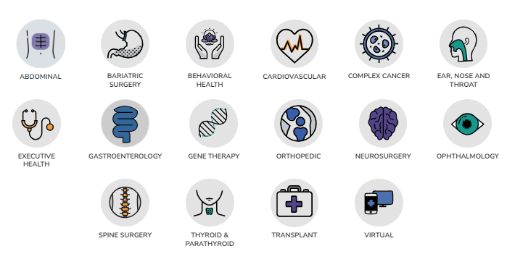
Your Health, Our Specialty
Over 300 unique procedures & 975 bundled contracts across 17 medical specialty categories.
WWW.ACCARENTHEALTH.COM

Slide 3
Our Centers of Excellence
WWW.ACCARENTHEALTH.COM

Slide 4
The Results: Tim’s Accarent Journey
From Pre-operative Testing to New Knee & Cancer-Free
Recovery
Diagnosis
Within 10 weeks of initial diagnosis, Tim was declared cancer free and healthy enough to return to work.
After pre-operative testing for a total knee replacement with a local provider, Tim, a labor worker in Southern PA found out that he had Kidney Cancer.
Surgical Treatment
With the Oncology team at Johns Hopkins aware of Tim’s case and the best path forward, Tim was scheduled for surgery the following month.
2nd Opinion
Through his employer’s partnership with Accarent, Tim, called to explore his options for treatment. Tim was quickly scheduled for a Diagnosis Confirmation & Treatment Planning Evaluation through Johns Hopkins where the diagnosis was confirmed and he was recommended a surgery to remove the cancer.
Tim received superior care and saved his company $10,000

Slide 5
The Accarent Experience
Members seeking care for a complex diagnosis and choosing treatment at an Accarent center will be paired with an Accarent Nurse Case Manager, who will provide the member with clinical support and act as their advocate with the Accarent center throughout their surgical journey.
CONTACT
CONSIDERATION
CONSULTATION
PROCEDURE
DISCHARGE
If you need specialized care, we're here for you. Simply reach out to us through our dedicated care support line or email, where our Nurse Case Managers are ready to assist with any medical or logistical questions you may have. They will also guide you through your available care options to ensure you make the best decision for your health.
The choice is yours. After discussing your available options with a Concierge or Case Manager from the Accarent health network, you may choose to proceed with a local provider or to receive treatment at one of Accarent's Centers of Excellence.
After you decide to proceed with an Accarent Health Center of Excellence provider, a Nurse Case Manager will facilitate the collection and transfer of your medical records to the chosen provider. The center will then contact you to schedule a comprehensive evaluation and conduct the necessary workup to determine the most suitable treatment plan.
If you are a surgical candidate and your procedure is scheduled, our Accarent Nurse Case Manager will be there to support you with any medical questions and help communicate your needs to the healthcare facility. Throughout your procedure, the Nurse Case Manager will maintain contact with the facility to help ensure everything goes as smoothly as possible.
After discharge, your Nurse Case Manager will guide you through your transition back home. They will work closely with your health plan to arrange for any necessary medical equipment, home care services, and schedule your follow-up appointments, whether they're at the facility or with your local doctor. Rest assured, they will also be on hand to answer any questions or address concerns you may have after your procedure.
WWW.ACCARENTHEALTH.COM

