Slide 1

Overview of Health Savings Accounts

Slide 2

HSA eligibility
You are eligible to open and contribute
to an HSA if:
You are covered by an HSA qualifying high deductible health plan (HDHP)
You are not covered by any other health plan that is not a high deductible plan
You are not enrolled in Medicare, TRICARE
or TRICARE for Life
  You must stop your HSA contribution one (1) month prior to turning 65 if starting Medicare (A, B, C or D) or six (6) months prior to starting Medicare any time after attaining age 65.
You are not claimed as a dependent on someone else’s tax return
You are not covered by a health care flexible spending account (FSA)
You have not received Veterans Administration (VA) benefits within the past three months, except for preventive care. If you are a veteran with a disability rating from the VA, this exclusion does not apply.

Slide 3
HSA overview
Requires a qualifying
high-deductible health plan (HDHP)
Used to pay
for qualified medical expenses immediately
Account funds
belong to you
Grows over
time and can
be invested
Investments are not FDIC insured, are not guaranteed by Optum Bank®, and may lose value.

Slide 4
Contribution limits
Amount
of contribution
The IRS determines how much you can deposit into your HSA
each year.
Contribution
rules
In 2027, you can contribute up to $4,500 for individual coverage and up to $9,000 for family coverage
Additional
contribution
Those 55 years of age or higher, but not yet enrolled in Medicare, can fund an additional $1,000/year “catch-up” contribution.

Slide 5



HSA qualified medical expenses
Medical plan
deductibles and coinsurance
Medical, dental
and vision care
services & products
Use HSA dollars to pay for qualified medical expenses for your spouse
or dependents

Slide 6
How to make deposits into your HSA
Payroll
deduction
Contribute through payroll deduction and save on FICA taxes; these contribution are pre-tax and offer the best savings.
Contribute online
Arrange a one time or recurring electronic transfer from an account at another financial institution; these contributions would be after-tax.
Mail a check
Deposit additional dollars into your account by mailing in a check; these contributions would be after-tax.
You can make HSA deposits until April 15th in order to realize tax savings for the prior year

Slide 7

Access your HSA funds
Use your Optum BankSM Health Savings Account Debit MasterCard®
Sign up for automatic bill pay
and online banking
Use HSA checks for this account
Pay for an expense with personal funds
and reimburse yourself from your HSA

Slide 8

Save your receipts!
Save your receipts for all qualified medical expenses
Our convenient receipt vault allows you to upload receipts and store them within your HSA online
Optum Bank® does not track your expenses or verify eligibility

Slide 9
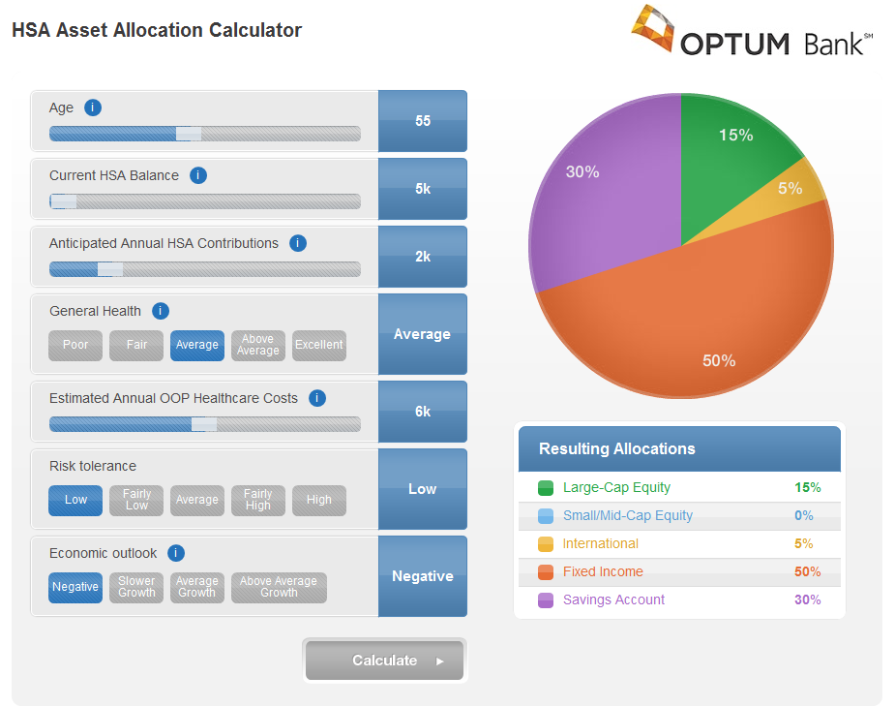

Investing your HSA
You can grow your HSA dollars by choosing to invest in mutual funds
Find the full list of mutual funds at optumbank.com
Investments are not FDIC insured, are not guaranteed by Optum Bank®, and may lose value.

Slide 10
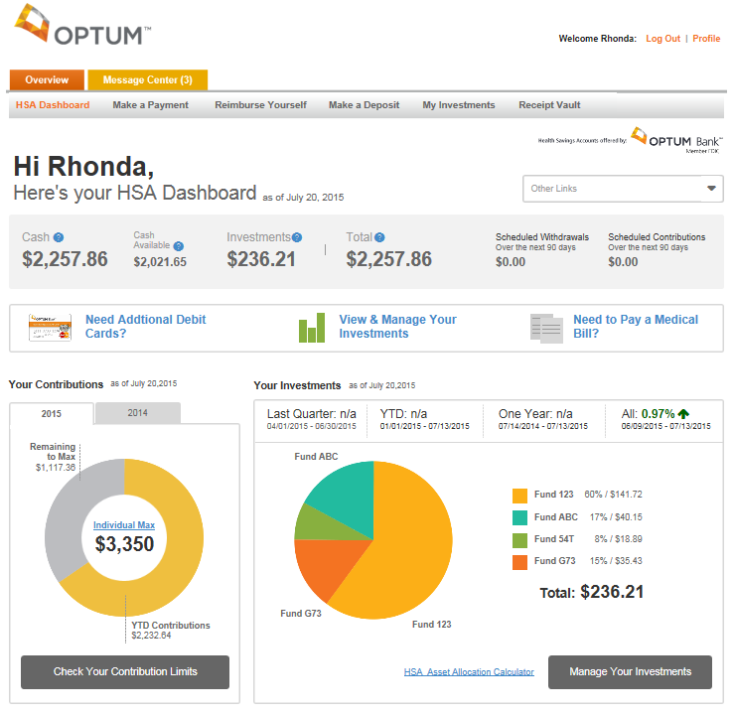
Managing your HSA online
Check your balance
Arrange deposits from another
banking account
Pay bills to health care providers
Reimburse yourself for qualified medical expenses paid out-of-pocket
Use HSA calculators
Check the contribution tracker for YTD contribution amounts
Use the convenient receipt vault
Manage investment activities
for your HSA
optumbank.com
Investments are not FDIC-insured, are not guaranteed by Optum Bank®, and may lose value.

Slide 11

What if you have more questions?
Call Optum Bank customer service (844) 326-7967
Visit optumbank.com
Talk to your employer

