Slide 1

Overview of Health Savings Accounts
Notes:
[Presenter’s Note: Please review this document and update particular sections. In addition, you may find it’s easier to read the notes if you go to File/Send To/Microsoft Word, and choose “Notes on the bottom.”
Welcome.
Thank you for taking time out of your day to review how you can use your health savings account, or HSA, to help pay for your current qualified health care expenses and save for future health care expenses while saving on taxes.
My name is [XXXXXXXXXXX] and I represent Optum Financial Services. We are a financial services company dedicated exclusively to health care. We’re part of Optum, one of the nation’s largest health and wellness companies that serves 60 million individuals. Optum Financial Services also administers flexible spending accounts, or FSAs, health reimbursement accounts, transportation accounts and COBRA services. Our subsidiary, Optum Bank, offers the Health Savings Accounts.

Slide 2

HSA eligibility
You are eligible to open and contribute
to an HSA if:
You are covered by an HSA qualifying high deductible health plan (HDHP)
You are not covered by any other health plan that is not a high deductible plan
You are not enrolled in Medicare, TRICARE
or TRICARE for Life
You are not claimed as a dependent on someone else’s tax return
You are not covered by a health care flexible spending account (FSA)
You have not received Veterans Administration (VA) benefits within the past three months, except for preventive care. If you are a veteran with a disability rating from the VA, this exclusion does not apply.
Notes:
You are eligible to open an contribute to an HSA if you meet these criteria:
First, you must be enrolled in an HSA qualifying high deductible health plan.
Second, you cannot be covered by any other health plan. For example, you cannot be covered by your spouse’s health care plan as well as this one.
Third, you cannot be enrolled in Medicare, TRICARE or TRICARE for Life.
Fourth, you cannot be claimed as a dependent on someone else’s tax return.
Fifth, you cannot be currently covered by a health care FSA. This is an important point. If you currently have a health care FSA and are enrolling in an HSA, you’ll want to spend down your FSA before the start of the HSA-eligible plan year to ensure you make the most of your FSA and transition smoothly to your new HSA.
And finally, you cannot have received Veterans Administration (VA) benefits within the past three months, except for preventive care. If you are a veteran with a disability rating from the VA, this exclusion does not apply.

Slide 3
HSA overview
Requires a qualifying
high-deductible health plan (HDHP)
Used to pay
for qualified medical expenses immediately
Account funds
belong to you
Grows over
time and can
be invested
Investments are not FDIC insured, are not guaranteed by Optum Bank®, and may lose value.
Notes:
First, you must be enrolled in an HSA qualifying high deductible health plan or HDHP before you can open, fund and use an HSA. Most HDHPs cover preventive visits at 100%, saving you even more. You can use your HSA contributions to help you pay for expenses that the HDHP doesn’t cover. The balance in your HSA is yours to keep, however, and can be used to pay for health care expenses or saved for future use. If you change medical plans and are no longer covered by an HDHP, you can no longer contribute to your HSA.
Second, HSA funds can be used immediately but only to pay for qualified medical expenses. The IRS determines which expenses can be paid for with HSA funds. If you use the funds for non-qualified expenses, you will be required to pay taxes on the funds, as well as pay a penalty. We will discuss qualified and non-qualified expenses shortly.
Third, HSAs can be funded by many sources. You can contribute after-tax income or, if your employer allows, you can contribute through payroll deduction. Plus, an employer and others, like family members, can make contributions. Contributions made by any of these sources will count toward the maximum IRS contribution limit.
Next, all funds in the account belong to you as soon as they are deposited, regardless of who contributed them. This means that the funds go with you if you leave your employer. You make all decisions about how and when you use your HSA funds.
Finally, your HSA funds can grow over time. HSAs are not covered by IRS “use it or lose it” rules. This means that unused funds remain in your account from year to year. Depending on the type of account you choose, your HSA balance can grow through new contributions, interest earnings or investment income.
There are a few other things that you need to keep in mind.

Slide 4
Contribution limits
Amount
of contribution
The IRS determines how much you can deposit into your HSA
each year.
Contribution
rules
In 2024, you can contribute up to $4,150 for individual coverage and up to $8,300 for family coverage
Additional
contribution
Those 55 years of age or higher, but not yet enrolled in Medicare, can fund an additional $1,000/year “catch-up” contribution.
Notes:
As I mentioned earlier, the IRS determines the maximum amount you can contribute to an HSA every year.
In 2016, you can contribute up to $3,350 if you sign up for the health care plan as an individual. If you sign up as a family or individual +1, the contribution limit goes up to $6,750. In 2017, you can contribute up to $3,400 for individual coverage and $6,750 for family coverage. The IRS allows people nearing retirement age to make additional “catch-up” contributions to help build balances to be used to help pay for health care costs during retirement.
You can contribute an additional $1,000 a year if you are 55 years or older.
If both you and your spouse are 55 or older, you can both contribute an additional $1,000. Your spouse will need to open his/her own HSA to make his/her own HSA catch-up contribution.
You are not eligible to make “catch-up” contributions if you are receiving Medicare benefits.
You can learn more about contribution limits and making catch-up contributions by going to irs.gov.
Now let’s learn how an individual might use an HSA to pay for health care costs and save on taxes.

Slide 5



HSA qualified medical expenses
Medical plan
deductibles and coinsurance
Medical, dental
and vision care
services & products
Use HSA dollars to pay for qualified medical expenses for your spouse
or dependents
Notes:
So, where can you use your HSA funds? You can use the money in your HSA to pay for “qualified medical expenses” identified by the IRS.
Qualified medical expenses include:
Medical plan deductibles and coinsurance.
Medical, dental and vision services and products, such as glasses.
Medical plan expenses, such as prescription drugs and doctor visits
You can use your HSA to pay for qualified expenses incurred by you, your spouse and your dependents even if they're not covered by your health care plan. Remember, any money you take out of your HSA for qualified medical expenses is income tax-free.
You can find a detailed list of qualified and non-qualified medical expenses by going to optumbank.com or irs.gov.
Generally, you cannot use HSA funds to pay for medical insurance premiums, but there are some exceptions. Let’s look at those.

Slide 6
How to make deposits into your HSA
Payroll
deduction
Contribute through payroll deduction and save on FICA taxes; these contribution are pre-tax and offer the best savings.
Contribute online
Arrange a one time or recurring electronic transfer from an account at another financial institution; these contributions would be after-tax.
Mail a check
Deposit additional dollars into your account by mailing in a check; these contributions would be after-tax.
You can make HSA deposits until April 15th in order to realize tax savings for the prior year
Notes:
You can make deposits to your HSA at any time during the year. There are several contribution methods you may want to consider.
First, if your employer offers payroll deduction contribution, you can chose to deduct a set amount from each paycheck to help build your balance automatically. Payroll deduction also offers increased tax savings of 7.65% from FICA taxes.
Second, you are free to add more to your HSA using after-tax income. You can set up a one time or recurring deposit to your account online. Or, you can always mail in a check. Any after-tax deposits will be listed on your tax return as a below the line tax deduction.
You will also want to keep in mind that you can make a contribution for the preceding tax year until April 15 to reap the tax benefits for the prior year. This is another way in which an HSA is similar to an IRA.

Slide 7

Access your HSA funds
Use your Optum BankSM Health Savings Account Debit MasterCard®
Sign up for automatic bill pay
and online banking
Use HSA checks for this account
Pay for an expense with personal funds
and reimburse yourself from your HSA
Notes:
While most of our account holders feel that the debit card is the easiest way to pay for health care expenses, there are a number of other ways you can use the funds. First, you can access your account to pay bills by signing up for automatic bill pay and online banking. This allows you to pay your bills online. You can also store the names and addresses of providers to make future payments more efficient, or you can even automate regular payments, such as to an orthodontist.
Another way to access your HSA is to order and use checks for your account. You can use these checks to pay medical bills. You can order HSA checks for $10 per book of 25 checks; you can also order checks from other establishments for your account.
If you’re looking to save for retirement, a great method is to pay for the expenses out of pocket. If you need the funds in the future, you can reimburse yourself for these later in the year, two years later, or even in retirement. Simply pay the bill with your regular credit card or check. When you need to be reimbursed, simply go online to use the reimbursement feature. Be sure to keep your receipts in case you are audited and the IRS requests documentation.

Slide 8

Save your receipts!
Save your receipts for all qualified medical expenses
Our convenient receipt vault allows you to upload receipts and store them within your HSA online
Optum Bank® does not track your expenses or verify eligibility
Notes:
Here are a few tips that can help save you a lot of time and headaches later on! Always save your receipts for all qualified medical expenses, note whether the qualified expense was paid for out of your HSA, then retain the receipt for future reference. You can use a file folder, a shoebox, or save them online. Whatever method works for you. Our convenient online receipt vault allows you to upload images of receipts for qualified medical expenses and then store them within your HSA. You can easily organize and manage your receipts from your smart phone, tablet or desktop.
Remember, Optum Bank does not track or verify your spending. That is your responsibility. You do not need to provide receipts in order to reimburse yourself from the account, however you should always save your receipts for future reference in the case of an IRS audit.
Now let’s check in with Molly to see how she accesses her HSA.

Slide 9
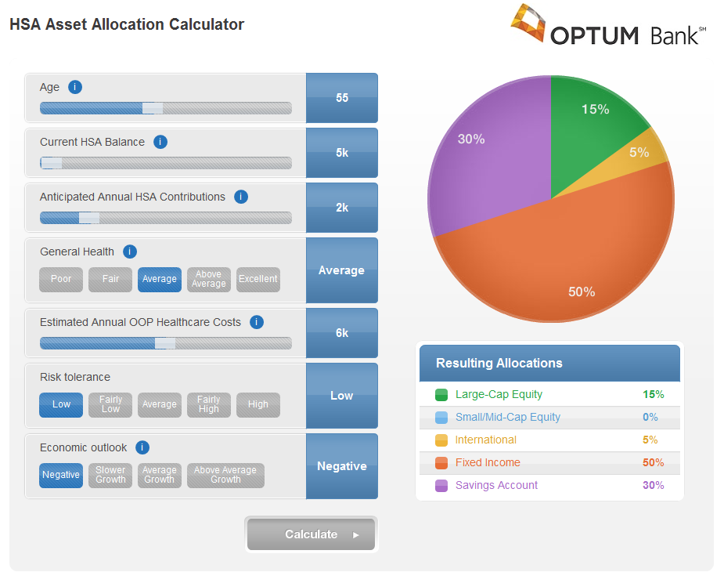
Investing your HSA
You can grow your HSA dollars by choosing to invest in mutual funds
Find the full list of mutual funds at optumbank.com
Investments are not FDIC insured, are not guaranteed by Optum Bank®, and may lose value.
Notes:
Once your HSA reaches $2,000, you may invest a portion of your HSA in mutual funds. Remember that the minimum transfer amount is $100.
Choose from dozens of funds ranging from conservative to aggressive. You can spread your money across multiple funds by designating the percentage you wish to allocate to each fund (to equal 100%). Our Asset Allocation Calculator, available after logging in to your account, can help you make your investment allocations …
Any earnings such as interest or dividends are tax-free earnings. Any distributions must still be used for qualified medical expenses only.

Slide 10
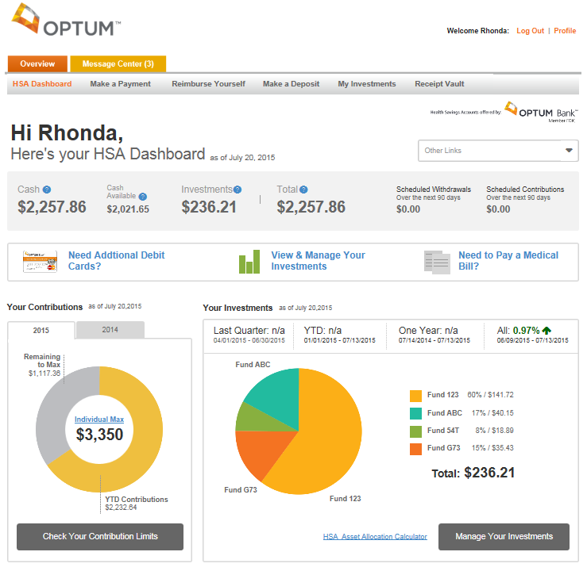
Managing your HSA online
Check your balance
Arrange deposits from another
banking account
Pay bills to health care providers
Reimburse yourself for qualified medical expenses paid out-of-pocket
Use HSA calculators
Check the contribution tracker for YTD contribution amounts
Use the convenient receipt vault
Manage investment activities
for your HSA
optumbank.com
Investments are not FDIC-insured, are not guaranteed by Optum Bank®, and may lose value.
Notes:
Optum Bank has created an easy-to-use web site for health savings account holders. You’ll find resources to help you learn about HSAs, as well as access HSA calculators to help you determine your annual contribution and potential tax savings.
There are many things that you can do from our website. You can make a contribution to your HSA at any time by arranging a one time or recurring deposit from another banking account.
If your provider does not accept MasterCard, you can pay health care providers through our online bill pay feature. Or, if you have paid for a qualified medical expense out-of-pocket, it is easy to reimburse yourself online. And it is easy to keep track of your receipts online by using our convenient receipt vault.
You will also have access to our contribution tracker, which shows you how much you have contributed to your HSA year to date and shows you how much you are eligible to contribute based on your plan type (individual or family).
Another great feature of the Optum Bank HSA is the ability to invest a portion of your HSA dollars into mutual funds, once your account reaches a designated threshold (typically $2,000). Keep in mind, though, that while deposits are insured by the FDIC up to $250,000, investments are not FDIC insured, are not guaranteed by Optum Bank, and may lose value.
However you choose to manage your account, it is easy to do online from your smart phone, tablet or desktop.

Slide 11

What if you have more questions?
Call Optum Bank customer service (844) 326-7967
Visit optumbank.com
Talk to your employer
Notes:
If you have questions about your HSA, you can call the toll-free customer service number listed on the back of your debit card. You can also visit optumbank.com. The web site contains lots of easy-to-use information, frequently-asked questions and tools to help you better understand your HSA. Or, you can talk to your employer.

