Slide 1




Welcome to 2026 Open Enrollment!

Slide 2

OPEN ENROLLMENT – IMPORTANT INFORMATION
Open Enrollment Window: October 6 through October 21, 2025
PASSIVE OPEN ENROLLMENT (UNLESS ADDING/DELETING DEPENDENTS, WANT TO CHANGE PLANS/WAIVE COVERAGE OR PARTICIPATE IN FSA or HSA).
Examples of why you should log into Oracle include:
  If you would like to change your plan election (this applies for all benefits, including medical, dental, voluntary, etc.)
  If you would like to change your coverage tier (i.e. Employee, Employee+ Spouse/DP, Employee+ Child, or Family coverage)
  If you would like to add/remove dependents
  If you are not currently enrolled in coverage but would like to enroll for 2026
  If you are currently enrolled in coverage but would like to waive for 2026
Once you have made your elections, you will not be able to change them until the next Open Enrollment period, unless you experience a qualified change in status.

Slide 3

What’s New for 2026?
Goldfinch Health –
Surgery Concierge Program
Dental –
enhanced program for special needs individuals
Balance Wellbeing Portal –
Financial Guidance
Achieve Well Being (enrolled in IBX medical plan). Updated program guidelines
HDHP - $0 Teladoc
Voluntary Benefits –
new standalone vision benefit

Slide 4

Devereux BenePortal
BenePortal features include:
Oracle Self-Service Information
Plan Summaries
Wellness Resources
Carrier Contacts
Downloadable forms
And more!

Slide 5

Enrollment and Eligibility

Slide 6
Eligibility Overview
All employees regularly scheduled to work 30+ hours or more per week are eligible to enroll in benefits
  *To be eligible for full-time employer paid benefits (Basic Life Insurance, Long Term Disability, Health Management Leave (HML) and Time-off Benefits (TOB), employees must be designated as full time.
Who can I cover under my benefits?
Employee
Employee + Child(ren) up to age 26
    Birth child(ren)
    Spouse/Domestic Partner’s birth child(ren)
    A child(ren) legally adopted or placed for adoption
    Child(ren) under a Qualified Medical Support Order (QMSCO), until age 26.
    Eligible disabled child(ren)
Employee + Spouse/Domestic Partner (DP)
Employee + Family
Required Dependent Verification Documentation – email or provide documents to PO
  Enrolling a Spouse: Copy of your marriage certificate, copy of Social Security Card
  Enrolling Children: Copy of birth certificate, copy of Social Security Card
  Enrolling Domestic Partner: Completion of Domestic Partner packet (obtain Domestic Partner packet from People Operations), copy of Social Security Card

Slide 7

premiums, deductibles and out of pocket maximums

Slide 8
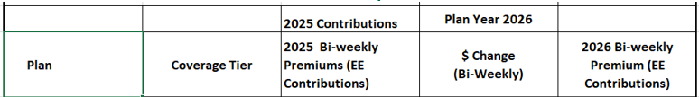
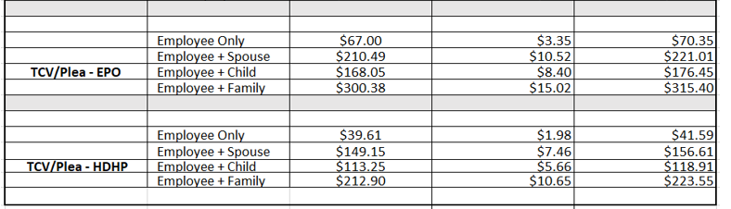
2026 Contributions – Medical (includes Rx/Vision

Slide 9
2026 Deductible and Out of Pocket Maximums
 |  | TCV/Plea EPO
DEDUCTIBLE | Employee Employee + 1 Child Employee/Spouse/DP or Family | $840 to $925 $1,260 to $1,390 $1,680 to $1,850
OUT-OF-POCKET MAXIMUM * (Includes Deductible) | Employee Employee + 1 Child Employee/Spouse/DP or Family | $5,200 to $5,720 $7,800 to $8,580 $10,400 to $11,440
* Separate OOP maximum for RX ($4,200/$6,300/$8,400)
 |  | HDHP
DEDUCTIBLE | Employee Employee + 1 Child Employee/Spouse/DP or Family | $3,098 to $3,408 $4,620 to $5,080 $6,195 to $6,815
OUT OF POCKET MAXIMUM (Includes Deductible) | Employee Employee + 1 Child Employee/Spouse/DP or Family | $4,725 to $5,200 $7,088 to $7,803 $9,450 to $10,400

Slide 10

2026 health benefits

Slide 11

MEDICAL & RX – INDEPENDENCE BLUE CROSS (IBX)
TCV/Plea EPO
  Deductible based on salary
  Lower deductible and out of pocket maximum
  Separate OOP Maximum on RX
  Preventive care 100% covered
High Deductible Health Plan (HDHP)
  Lower Premiums
  High deductible
  After deductible plan covers 75% of care
  Preventive care 100% covered
  No separate OOP for RX

Slide 12
Medical Plan Options
 | TCV/Plea EPO | High deductible health plan
In-network benefits
Calendar Year Deductible (Employee Employee + Child Family (Includes EE+ Spouse/DP, Employee + Children) | $925/$1,390/$1,850 | $3,408/$5,080/$6,815
Out-of-Pocket Maximum (Employee Employee + Child Family (includes EE + Spouse/DP, Employee + Children) | $5,720/$8,580/$11,440 | $5,200/$7,803/$10,400
Preventive Care Services | $0 Copay, no deductible | 0%, no deductible
PCP Office Visit | $25; no deductible | 25% after deductible
Specialist Office Visit | $50; no deductible | 25% after deductible
Telemedicine (TelaDOC) | $0 Copay; no deductible | $0 Copay; no deductible
Emergency Room (Copay waived if admitted) | $300; no deductible | 25% after deductible
Urgent Care Center | $50; no deductible | 25% after deductible

Slide 13

Prescription Drug Plans
Ibx prescription plan for TCV/Plea Medical plans (Epo)* included with TCV/Plea medical plan election
In-network only | Retail pharmacy (up to 90-day supply) | mail order pharmacy (up to 90-day supply)
Generic | 15% ($5 minimum) | 15% ($5 minimum)
Preferred brand | 35% ($10 minimum) | 35% ($10 minimum)
Non-preferred brand | 50% | 50%
* 90-day fill available at CVS Only or through Mail Order (after 1st retail fill)
* Separate OOP maximum for RX ($4,200/$6,300/$8,400)
Ibx prescription plan for the high deductible health plan included with hdhp medical election
In-network only | Retail pharmacy (up to 30-day supply) | mail order pharmacy (up to 90-day supply)
Generic | 75% after deductible; covered 100% after out-of-pocket maximum is met | 75% after deductible; covered 100% after out-of-pocket maximum is met
Preferred brand
Non-preferred brand

Slide 14

Telemedicine – IBX medical Plans
Teladoc Telemedicine – www.teladochealth.com
Teladoc is a national network of U.S. board-certified doctors available 24/7/365 to diagnose, treat and prescribe medication when necessary for many common medical issues. Teladoc uses digital devices such as computers, smartphones, and video conferencing.
Using telemedicine is a convenient option when it is not possible to visit your doctor's office for a non-emergency medical conditions.
      Covered Medical Conditions:
Allergies
Asthma
Acne
Pink eye
Ear Infections
Sinus issues
Respiratory infections
Urinary tract infections
Cold and flu symptoms
      Coverage also includes:
      Behavioral Health
      Dermatology
$0 copay all IBX Medical Plans

Slide 15

Vision plan – Davis vision included w/medical
NETWORK | In-network | Out-of-network reimbursement
Annual plan maximum | Unlimited | Unlimited
deductible (Individual/Family) | $0 / $0 | $0 / $0
Out-of-pocket maximum (Individual/Family) | $0 / $0 | $0 / $0
Routine Vision Exam at davis vision participating provider | No charge | $40 reimbursement
Frequency | 12/12/12 (you must be aware of when vision benefits were utilized in prior year)
Frames Davis Vision Collection Fashion or Designer Frames Davis Vision Collection Premier Frames Non-Davis Vision Collection Frames Visionworks Frames Option | No charge $25 Up to $130 allowance; 20% discount on overage Up to $180 allowance; 20% discount on overage | N/A N/A $50 reimbursement N/A
Lenses Single Vision Bifocal Trifocal Lenticular | No charge | $40 reimbursement $60 reimbursement $80 reimbursement $100 reimbursement
Contact lenses & evaluation (in lieu of eyeglasses) Davis Vision Collection – Standard, Specialty, or Disposable Contact Lenses Evaluation at a Davis Vision Participating Provider Non-Davis Vision Collection Contact Lenses Non-Davis Vision Evaluation | No charge No charge Up to $130 allowance; 15% discount on overage Up to $60 allowance; 15% discount on overage | $105 reimbursement
Contact lenses (medically necessary) | No charge | $225 reimbursement

Slide 16

Wellness program
Available to employees enrolled in one of Devereux’s Independence Blue Cross medical
plans.
  GIFT CARD REWARD PROGRAM
    Employees and Spouses/DPs may earn up $300 by completing the following:
      Primary Care Visit - $100
      Age appropriate health screening (Physical, Mammogram, Colonoscopy, etc.) - $100
      Completion of Personal Health Profile - $50
      Teladoc Visit - $25
      Immunization - $25
    Effective 1/1/2026 through 12/31/2026
The Living Healthier Contest continues in 2026
Preventive care and screenings enter you into the raffle to receive free “Single” health insurance for 2027!
One winner at each center.

Slide 17

GOLDFINCH HEALTH
CONCIERGE SURGICAL BENEFIT:
Goldfinch Health is provided free to those enrolled in Devereux medical benefits provided through Independence Blue Cross (IBX).
  If you need an operation, Goldfinch will help guide you through surgery and recovery.
    Make your surgery forgettable – with Goldfinch Health, you can relax knowing you’ll have support from your own personal nurse 24/7 to help guide you every step of the way.
      Surgical game plan
      Pain management plan
      Access to surgeons in the IBX network that guarantee the most advanced techniques.
        Surgical approach that significantly lowers the chance of complications.
Visit My.goldfinchhealth.com or call 833.453.3624

Slide 18

SAVINGS CONSIDERATIONS – ACCARENT HEALTH
If you participate in Devereux’s Medical Benefits, you can choose to have $0 out of pocket costs for certain surgical procedures by using Accarent.
    Network of select academic medical centers and top-rated hospitals established in conjunction with Johns Hopkins Hospital.
    All initial treatment and any complication or concurrent related illness, outpatient follow-up during the post-surgical period, personalized nurse case management, and concierge and travel assistance are covered under the program.
Contact Accarent at (866) 771-0697 for immediate assistance or visit www.accarenthealth.com to see the schedule of services and how it works!
$0 Cost for surgical procedures at top-rated hospitals. Need to travel? Devereux will reimburse you and a caregiver for your travel expenses, including a hotel stay, for the day prior to surgery and aftercare based on the Accarent post-operative schedule.
Grail Genetic Testing through Accarent – if you are 50+ or 40+ with a family history, lab tests are
available that may detect up to 50 active cancers. Cost is $1,000 and is payable using Health Savings Account (HSA),
Flexible Spending Account (FSA) or credit card. Contact Accarent at (866) 771-0697 for information.

Slide 19
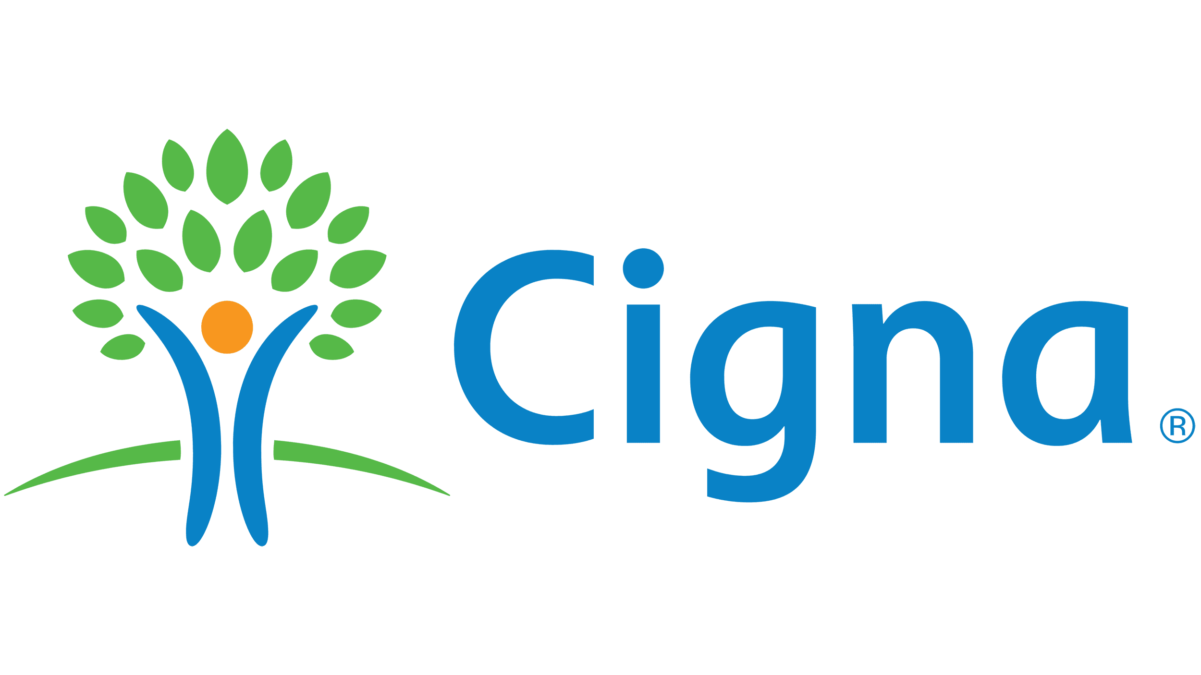
DENTAL PLANS - CIGNA
Dental plans | PPO plan A |  | PPO plan B |  | Dhmo
NETWORK | Advantage Providers | Premier Providers & out-of-network | Advantage Providers | Premier Providers & out-of-network | IN-NETWORK ONLY
Calendar year deductible (Individual/Family) | $50 / $150 |  | $75 / $225 |  | No deductible
Calendar Year Maximum (Per patient) | $2,000 | $1,000 | $2,000 | $1,000 | No yearly maximum
Preventive & Diagnostic Services Exams, Cleanings, Bitewing X-rays (each twice in a calendar year) Fluoride Treatment (once in a calendar year, children to age 19) | 100% covered; no deductible |  | 100% covered; no deductible |  | 100% covered
Basic Services Fillings, Extractions, Endodontics (root canal), Periodontics, Oral Surgery Sealants | Plan pays 70%* 100% covered; no deductible |  | Plan pays 50%* 100% covered; no deductible |  | Plan pays 90%
Major Services Crowns, Gold Restorations, Bridgework, Full and Partial Dentures | Plan pays 60%* |  | Plan pays 50%* |  | Plan pays 60%
Orthodontia Benefits (CHILDREN UP TO AGE 19) | Separate Deductible: $50; Plan pays 50%* |  | Separate Deductible: $75; Plan pays 50%* |  | Plan pays 50%
Orthodontia Benefits (Adults) | Separate Deductible: $50; Plan pays 50%* |  | Separate Deductible: $75; Plan pays 50%* |  | Plan pays 50%
Implants | Plan pays 60%* |  | Plan pays 50%* |  | N/A
Orthodontia Lifetime Maximum (per patient) | $1,500 | $1,000 | $1,000 | $750 | 24 months of comprehensive orthodontic treatment plus 24 months of retention

Slide 20
Dental Plan Types
The DPPO plans (Plan A and Plan B) offer the convenience and flexibility of visiting any licensed dentist, anywhere.
    Covered services are paid based on a percentage
      For example: fillings are covered at 80%, you pay the remaining 20%
Under the DHMO Plan, members have their choice of skilled primary dentists from the Cigna network
    Select a primary dentist who will then coordinate any needed referrals to a specialist.
    There are no maximums or deductibles

Slide 21
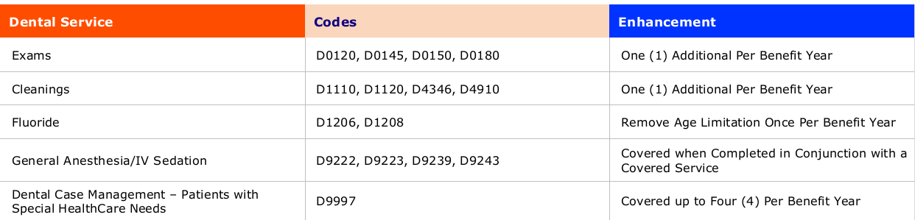
the Dental Special Healthcare needs Program
The Dental Special Healthcare Needs Program
    Accommodates employees and their families with any physical, developmental, mental, sensory, behavioral, cognitive or emotional impairment or limiting condition that requires medical management, healthcare intervention and/or use of specialized services.
      Employees will enroll in the program by contacting Cigna at 800-882-4462 and completing an intake form.

Slide 22

Flexible Spending accounts
Medical Spending Account* | Dependent Care Spending Account
2026 Contribution: Maximum of $3,400 | 2026 Contribution: Maximum of $7,500 $3,750 for married individuals filing separate tax return
$680 Carryover limit into 2027 | No Carry Over
eligible Expenses: Non-cosmetic dental Office Copays Vision Other medical expenses etc. | eligible Expenses: Au Pair or nanny Before & After school care Childcare Eldercare
*Medical Spending Account is not available to HDHP enrollees; HDHP is eligible to enroll in a HSA plan

Slide 23
Flexible Spending accounts (continued)
Important rules for both the Medical & Dependent care FSA Accounts
The ”use it or lose it” rule.
Accounts are Separate; cannot transfer money from one to the other.
Cannot change your election until next enrollment period (unless you have a change in family status called a qualified family status change).
mUST re-enroll every year (enrollment won’t continue automatically).
Plan year extended to 14.5 months, allowing you to submit expenses for reimbursement through mid-March of the following calendar year.
Save your receipts for claim substantiation.
IMPORTANT NOTE: If you do not enroll in the Flexible Spending Account and have rollover money from the previous year, that money becomes a limited flexible spending account and may be used only for vision and dental expenses.

Slide 24

Transportation/PARKING benefits – COMMUTEEASE
CommuteEase is a pre-tax benefit that helps you pay transportation and parking costs if you take public transportation or have to pay to park at the train or office.
Contributions to your CommuteEase plan is directly through Employee Benefits Corporation’s member portal - paid by the 13th of each month for the upcoming month. Contributions will be available on the EBC Benefits Card. EBC provides Devereux the election amount and that amount is deducted from the employees check the last pay of each month.
Unused funds carryover to the next year for CommuteEase.
Contribution Limit: $340 per month (projected).

Slide 25


Health Savings Account (HSA)
Health Savings Accounts (HSA) - Can only be combined with the High Deductible Health Plan
An HSA is like a flexible spending account but rolls over each year and is never forfeited. There is no “use it or lose it" rule.
  The maximum amount for 2026 is $4,400 for employees with single coverage and $8,750 for employees with two-person or family coverage. The plan allows an additional $1,000 catch-up contribution for those aged 55-64. If you don’t enroll in Medicare Part A or Part B, you may continue participating
  These contributions can be used to cover medical, dental, vision and other healthcare related expenses
Money saved in an HSA plan is the employees, and is portable (take it with them if they leave Devereux). At retirement, there are additional post-employment uses for HSA savings, such as paying for Medicare premiums
Investment options are available for long term savings

Slide 26

Member advocacy Team – CSB benefits mac
Conner Strong & Buckelew’s (CSB) Member Advocacy Center is here to help you with all your benefits related needs
The Member Advocacy Center can help answer questions or resolve issues such as:
  Understanding how your benefit plan works
  Questions regarding a bill you received from a doctor, lab or hospital
  Researching a claim that was not paid properly
You can reach a Member Advocacy representative by any of the following:
  Calling - (800) 563-9929 Monday through Friday, 8:30 am to 5:00 pm EST and 7:30 am to 4:00pm CST
  Visiting - www.connerstrong.com
  Emailing - cssteam@connerstrong.com
  Faxing - (856) 685-2253

Slide 27

Financial security

Slide 28

Retirement - TIAA
    2026 Contribution limits:
  The annual IRS maximum contribution for 2026 is $24,500
  Employees age 50 or over can make a catch-up contribution up to additional $8,000.
  Secure Act 2.0 catch-up contribution for those 60-63 in 2026 is up to an additional $11,250.
  Employees with 15 or more years of service can possibly make a catch-up contribution of up to an additional $3,000. Have employees contact TIAA to run the calculation.
  Employees age 50 or over that have 15 or more years of service can possibly make a catch-up contribution of up to an additional $9,500. Have employees contact TIAA to run the calculation.
Devereux’s Matching Contribution
  Amount varies by center
  Contribution is made 1x per year in January
Contact info:
  TIAA
    www.tiaa.org/Devereux
    Advisors are available Monday - Friday, 8 a.m. - 10 p.m. (ET) at (800) 842-2252
      Janney Montgomery Scott
        Devereux’s Plan Advisors at Janney Montgomery Scott are Quinn Karpiak and Scott Karpiak
        You can call (800) 567-2687 Toll Free, call direct by dialing (215) 665-6010, or email QKarpiak@janney.com

Slide 29


Devereux Ascend
Career Accelerator Program
Student Tuition Assistance
  Funding up to 100% of the costs of exam fees, training, tuition and study materials to support every career path.
Student Loan Debt Solution
  Robust benefit for those who have completed their education and assistance to apply for Public Service Loan Forgiveness. Team members will go through Savi for PSLF eligibility. Devereux will pay fee for those who qualify.
Mentoring and Development
  Development options with focus on individual and equity within the organization.

Slide 30
BALANCE WELLBEING
A FINANCIAL WELLNESS SOLUTION
Balance Wellbeing with New York Life is offered to you at no cost as part of your Devereux benefits.
Stabilize your financial foundation and advance your financial wellbeing with help to:
  Improve money management, budgeting, debt management
  Protect who and what matters most – dependents, spouses/partners, family
  Plan for an navigate life goals and events – disability, children, college
  Optimize savings and investments
  Build and transfer wealth – legacy, caregiving
  Tap into human advice and guidance – family financial wellness, debt consult
How does sign up work?
  Go to https://app.balancewellbeing.com/sign-up/invite-code
  Enter code: devereux
  Create a password and enter your email, phone, name, address, date of birth
  Verify your email address within 48 hours – and you’re done!
    It’s that easy.
Not quite ready to sign up? Learn more at www.balancewellbeing.com

Slide 31

Voluntary benefits

Slide 32

Voluntary Dependent life insurance
Voluntary Spouse/DP Life insurance | Voluntary Child Life
Up to $50,000 available: New Hires – up to $50,000 Guaranteed Issue Existing Employee – may elect/increase in $5,000 increments (if electing more than $5,000, subject to EOI) | $10,000 policy available: New Hires – up to $10,000 Guaranteed Issue Existing Employee – $10,000
Rates are based on spouse/DP’s age and the amount elected | Rates are $.70 for $10,000 (14 days -26 years) Coverage ends at age 26
Available to 30+ hour employees

Slide 33
Voluntary Accidental Death and Dismemberment (ad&d)
AD&D insurance is an inexpensive way to provide additional life insurance
benefits if the cause of death is accidental. It also pays a benefit if there is a
loss of a limb, vision, or hearing due to an accident
$10,000 up to $500,000 not to exceed 10x annual salary
Coverage is elected in $10,000 increments
Option of Employee Only or Family Plan Coverage
  Family plan provides
    100% employee
    50% spouse/DP
    15% child of amount elected
Coverage amount for employees that attain age 70 or older are reduced:
  Age 70 – reduced by 65%
  Age 75 - reduced by 40%
  Age 80 – reduced by 30%
  Age 85 – reduced by 15%
Available to scheduled 30+ hour employees

Slide 34

Disability Benefits – New York Life (NYL)
When an unexpected illness or injury occurs, your focus should be on your health, not your budget. In the event that you become disabled from a non-work-related injury or sickness, disability income benefits will provide a partial replacement of lost income.
Voluntary Short-Term Disability (30+ Hour Employees)
Payroll deductions – 100% Employee Paid
  Rate is based on age and the amount you elect
  Coverage is 60% of your salary up to a maximum of $1,500 per week
  Two elimination periods to choose from: 14 Days and 28 Days
    An elimination period is the number of days you must wait until the benefit kicks in
    Employees who select this insurance may use Health Medical Leave (HML) or Time-Off Benefit (TOB) or not be paid to satisfy the elimination period until short-term disability coverage begins
    Benefit continues until you meet the definition of disability. After 11 weeks, you will become eligible for Long-Term Disability benefit, a benefit paid for by Devereux.
Employer Paid Long-Term Disability (Full Time employees)
  No cost to you – funded through Devereux
  60% of salary
  After 90 days out of work or longer
  From 90 days until normal social security retirement age or if you return to work

Slide 35
Voluntary Hospital Care INSURANCE
A hospital stay can be expensive, and it can happen at any time. Even with our medical coverage, out-of-pocket expenses such as rehabilitation, transportation and childcare can quickly add up. Supplemental health benefits offer a cost-effective solution to provide the additional coverage to help you bounce back from a health setback.
Benefit Type | Benefit Amount
Hospital Admission No elimination period. Limited to 1 day, 1 benefit(s) every 90 days. | $1,000 per day
Hospital Chronic Condition Admission No elimination period. Limited to 1 day, 1 benefit(s) every 90 days. | $50 per day
Hospital Stay No elimination period. Limited to 30 days, 1 benefit(s) every 90 days. | $100 per day
Hospital Intensive Care Unit Stay No elimination period. Limited to 30 days, 1 benefit(s) every 90 days. | $200 per day
Hospital Observation Stay 24-hour elimination period. Limited to 72 hours. | $100 per day
Available to scheduled 30+ hour employees

Slide 36
Voluntary Critical illness insurance - NYL
This plan can help ease some of your financial worries so you can stay focused on your health. You choose how to spend or save your benefit. It can be used for expenses, such as:
Paying for childcare or help around the house
Travel costs to see a specialist
Medical treatment and doctor visits
Copays and deductibles
Prescription drug costs
Coverage | Benefit Amount | Guaranteed Issue Amount
Employee | Plan 1 $10,000 Plan 2 $20,000 | Up to $20,000
Spouse/DP | 50% of employee amount | Up to $10,000
Children | 25% of employee amount | All guaranteed issue
Covered Diagnosis:
Invasive Cancer
Carcinoma in Situ
Vascular Conditions
Nervous System Conditions
Infectious Conditions
* See BenePortal for Benefit Summary and Coverage
Available to scheduled 30+ hour employees

Slide 37
Voluntary accidental injury INSURANCE - NYL
Guaranteed Issue: No medical underwriting
Plan provides a schedule of benefits for covered injuries and accident-related expenses for Off the Job accident coverage only that results within 90 days of the accident.
  A physician must diagnose covered losses.
  Treatment must be received in the United States or its territories.
$50 per year Wellness, Health Screening and/or Preventative Care Benefit Credit per covered person per calendar year. (Must submit wellness claim within 90 days of the date of service.)
What is Accident Injury Insurance? | Benefits may be payable for:
Accidental Injury Insurance Helps to pay for expenses associated with a covered accident or injury.
Covered Injuries may include:
Broken Bones
Burns
Torn ligaments
Concussions
Eye injuries
Ruptured discs
Cuts requiring stitches
Ambulance
Initial treatment
Emergency room visit
Hospitalization
Admission (per occurrence)
Confinement (per day)
Follow-up care
X-rays
MRI’s
Rehab
Available to scheduled 30+ hour employees

Slide 38
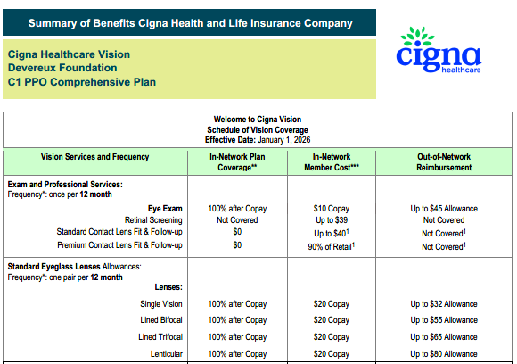
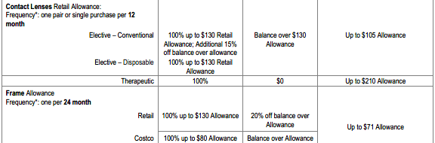
NEW – Voluntary Vision provided by EyeMed through Cigna.
Biweekly Rates
Employee Only - $4.08
Employee/Child - $8.25
Employee/Spouse - $8.17
Family - $13.17

Slide 39


Security & legal benefits
LegalShield
Helps to protect you and your eligible family members by providing preventive legal services, trial defense services and more.
IDShield
Helps to protect your, and if you choose your eligible family members identity, by providing consultative services to help you avoid ID Theft and fraud
Services Include but are not limited to:
Estate Planning – Wills, Advanced directives,
document review and more
Trial Defense Services
IRS Audits
25% discounted legal services for other issues not
included in contract
Family and Domestic Related Services Including:
  Uncontested divorce or separation
  Adoption
  Name changes
24/7 Emergency telephone access to an attorney if:
  Detained by law enforcement
  Involved in a vehicular accident that results
  in bodily harm or injury
  Estate Planning – Wills, Advanced directives, document review and more
Services Include:
24/7/365 access for emergency situations if an
identity theft occurs
Credit and Court Records monitoring
Credit Injury Alerts
Identity Restoration
Security monitoring of personal identifying
information on:
  Websites, Internet Relay Chat (IRC), chat
  rooms and peer sharing networks
Privacy monitoring
  Black Market website surveillance (internet monitoring)
  Address change verification

Slide 40

Pet insurance benefits
Contact Pet Benefit Solutions at (800)-891-2565 or visit www.petbenefits.com
Total Pet Plan
Wishbone Pet Insurance
The pet care bundle includes everyday savings on veterinary care, pet products and access to other benefits from PetPlus, Pet Assure, AskVet and The Pet Tag.
No exclusions based on breed, age or pre-existing conditions.
Coverage for all pets from cats and dogs to exotic animals and farm animals.
Can be used alongside pet insurance you already have or with Wishbone Pet Insurance
Member only pricing (up to 40% discount) on brand name prescriptions, food, treats and toys.
Free shipping on all orders from petcarerx.com and same day-pickup on human grade prescriptions at over 50,000 Caremark/CVS pharmacies.
Instant 25% discount on in-house medical services at participating veterinarians which means no claim forms and not waiting for reimbursement.
$250 Annual Deductible, 90% coverage and $25,000 annual limit
Provides 90% reimbursement on accidents and illness, including office visits and prescription medications. You can choose to add on routine care coverage. Everything your pet needs for one low price. Save 65% on retail rates.
Accident and Illness Coverage – includes office visits, exam fees and take-home Rx
Coverage on hereditary & congenital conditions, but pre-existing conditions do apply
No waiting period for injuries and illnesses and 6 months for cruciate ligament events. Waiting period starts on the policy effective date.
Choice of two add-on plans for routine veterinary care. The Pedigree add-on is a schedule of benefits that provides up to $305 in annual benefits with no deductible for approximately $14/month. The Best in Show Plan is a schedule of benefits that provides up to $535 in annual benefits with no deductible for approximately $23/month. These services include spay/neuter, rabies vaccine, flea/tick/heartworm prevention, vaccination, wellness exam, heartworm test, blood fecal, parasite exam, microchip, urinalysis and deworming.

Slide 41

Devereux Provided - Free
(100% Devereux paid)
INSURANCE ASSISTANCE
Life insurance 2x Salary to a maximum of $200,000 (full-time employees)
Long Term Disability – Devereux provides all full-time active employees with a minimum of 60% income replacement if out of work due to a disabling condition for 90 days or longer. This important paycheck protection benefit pays benefits directly to you and may be continued to Normal Social Security Retirement Age if you continue to meet the definition of disability. (full-time employees)
In addition to CSB’s Benefits Member Advocacy Center you also have Advocacy support through NY Life at www.guidanceresources.com offers trained advocates to help you navigate healthcare even if you are not on a Devereux benefit plan. Services include claim and billing issues, appeal processes and simplifying complicated administrative services and address questions and concerns. Use ID: NYLGBS
Secure Travel through NY Life at www.guidanceresources.com offers pre-trip planning and 24/7/365 support when traveling more than 100 miles away on vacation. Services include help with medical evacuations, repatriation and lost fees due to travel changes or emergencies. Use ID: NYLGBS
GoodRx – savings on Rx costs that may be less expensive than what is covered by insurance. Start saving at https://connerstrong.goodrx.com
Lilly Direct – savings on cost of GLP1 weight loss drugs by going straight to the manufacturer. www.lilydirect.com

Slide 42

Devereux Provided - Free to You (100% devereux paid)
FINANCIAL ASSISTANCE
Visit www.tiaa.org/devereux for individual consultations, advice and counseling including on-demand webinars, calculator and tools. Help is also available by calling 800-842-2252 to meet with an advisor to help with investment decisions.
Janney Montgomery Scott, Devereux’s Retirement Plan advisors are available to help with retirement and financial questions by calling (800) 567-2687 or emailing QKarpiak@janney.com.
Senior Advisors – Medicare Specialists providing education, choices and recommendations on Medicare coverage, including Plan A, Plan B, Medicare Advantage Plans (Plan C), and Medicare Supplement Plans (Medigap). Our specialists can be reached by calling 908-272-1970 or at www.senior-advisors.com
Financial, Legal and Estate Guidance through NY Life at www.guidanceresources.com offers professional services that include unlimited financial support on issues like debt management, family budgeting, estate planning, law and tax consultations and much more. pre-trip planning and 24/7/365 support when traveling more than 100 miles away on vacation. Services include help with medical evacuations, repatriation and lost fees due to travel changes or emergencies. Use ID: NYLGBS
Family Source and Guidance Resources through NY Life at www.guidanceresources.com are specialists that provide customized research, educational materials and prescreened referrals for childcare, adoption, eldercare, education and pet care. They can also assist with question on home and auto insurance and general questions through “Ask the Expert” which provides personal responses to your questions. Use ID: NYLGBS

Slide 43

Devereux Provided - Free to You (100% Devereux paid)
Well-being, Emotional, Behavioral Health Support
Carebridge can help with managing family and personal concerns including childcare, parenting, eldercare, money management, education planning, time management, convenience services, legal resources, relocation and more.
  Help is confidential and available 24/7/365 by calling (800) 437-0911.
  Five free, per topic, in person or virtual counseling services to assist you and your dependent family members with emotional concerns such as grief, stress, relationship difficulties, depression, anxiety, or other behavioral health challenges and addictions.
  Discounted shopping and other helpful resources are available at www.myliferesource.com and on the Carebridge app. The initial access code is ADC53.
Resiliency – Learn how to grow, thrive and flourish by taking care of yourself first, so you can take care of others. Fill your pitcher and build your bounce with videos, webinars and other resources hosted by Devereux’s DCRC team. Access #DevereuxStrong to enhance your well-being.
Wellness support through NY Life at www.guidanceresources.com offers three face to face counseling sessions, five telehealth resiliency coaching sessions and wellness articles, podcasts, videos and more 24/7.
Utopia Health – free service helps you locate nutritionists who provide six-free consultations through your medical plan.

Slide 44
Explanation of Accruals for health management leave (HML) and time-off benefit (TOB)
Benefit | Years of Service* | Accrual Factor | Annual Accrual Maximum | Earned on 80 Hours Worked
HML – FT Staff* | Date of Hire | .0500 | 64 Hours | 4.00 Hours
TOB – VP, ED, OOP | < 1 Year | 2.6 day per month | Determined by # of months
 | 1 year – 19 years | 31 days | Front loaded 7/1 of each year
 | 20 + Years | 36 days | Front loaded 7/1 of each year
TOB – FT Staff* | Day 1 - 2 Years | .0923 | 192 | 7.38 Hours
 | 3 Years – 4 Years | .0962 | 200 | 7.70 Hours
 | 5 Years – 9 Years | .1000 | 208 | 8.00 Hours
 | 10 Years – 14 Years | .1192 | 248 | 9.54 Hours
 | 15+ Years | .1385 | 288 | 11.08 Hours
Education/School Based Programs | Time Off Benefits (TOB) and Health Medical Leave (HML) vary by program and location. Please check with People Operations or your supervisor for details
* Available to Full-time employees, 36 hour FTE Nursing, and 37.5+ hour employees only

Slide 45
Carrier contacts
Benefits / Resources | Provider Name | Phone Number | Contact Information
Medical/Vision | Independence Blue Cross (IBX) | 877.393.6740 | www.ibx.com
Prescription drug | Independence Blue Cross (IBX) | 888.678.7012 | www.ibx.com
Dental, Dental Special Healthcare Needs Program/ Voluntary Vision | Cigna | 800.564.7642 | www.mycigna.com
Telemedicine | Teladoc | 800.835.2632 | www.Teladochealth.com
Health Savings Account (HSA) | Optum Bank | 866.234.8913 | www.optumbank.com
Flexible Spending (FSA)/Dependent Care SPENDING (DCARE) Accounts | Employee Benefits Corporation | 800.346.2126 | www.ebcflex.com
Life, LTD and Voluntary Benefits | New York Life | 800.238.2125 | www.mynylgbs.com
Retirement Benefits | TIAA | 800.842.2252 | www.tiaa.org/devereux
Pet Benefits | Pet Benefit Solutions | 800.891.2565 | www.petbenefits.com
Employee Assistance | Carebridge & eM Life | 800.437.0911 | www.carebridgenow.com
Advocacy Services | CSB Benefits MAC | 800.563.9929 | www.connerstrong.com/memberadvocacy

Slide 46
OPEN ENROLLMENT – REPORTS AND REQUIREMENTS
Splash BI reports:
  DEV Benefits Enrollment Results
    As of Date should be 01/01/2026
  Dev Dependents Report
    As of Date should be 01/01/2026
Confirmation statements do not need to be collected and scanned to PO.
  Employees should still print a confirmation statement for their records. Please be aware that since we are not collecting signed statements, that what is contained in Oracle is what the employee has elected and no changes will be made unless it is still Open Enrollment.
Health Savings Account Salary Reduction Agreements will be required for catch-up or front-load only.
Supporting documentation such as marriage certificates, birth certificates, Social Security Cards, etc. are still required and must be returned to Corporate PO by 11/08/2025 to benefits@devereux.org.

Slide 47
Questions?
Contact People Operations
- or -
our BenePortal www.mydevereuxbenefits.org
for more information
Notes:
Happy Open Enrollment!

Slide 49


